Slide 1

SOA-Based ML Services for Airfare Prediction
This presentation details our project on predicting airplane fare prices using machine learning techniques within a Service-Oriented Architecture (SOA). Our approach ensures modularity, scalability, and maintainability.
Group Members:
Prashansa Rathod - 8993410
Jaiv Burman - 8930180
Nidhi Ahir - 9041129
Harsh Joshi - 8952840
Nil Kumar Patel - 8983991

Slide 2
Data Collection Service
Functionality
Technology Stack
Operations
Gathers data from various airline sources and stores it in structured formats, preparing it for subsequent processing.
Utilizes Pandas, NumPy, and Jupyter Notebook for efficient data handling and exploration.
Reads CSV files containing flight information and organizes data for preprocessing, ensuring data integrity.

Slide 3

Data Preprocessing Service
1
Functionality
2
Technology Stack
Cleans and transforms raw flight data to ensure quality and consistency for model training.
Employs Pandas, NumPy, and Scikit-learn for effective data manipulation and transformation.
3
Operations
Handles missing values, converts categorical features, and normalizes numerical values to optimize data.

Slide 4

Feature Engineering Service
Functionality
Technology Stack
Extracts relevant features to improve fare prediction accuracy, enhancing model performance.
Leverages Scikit-learn and Pandas for efficient feature extraction and manipulation.
Operations
Extracts date-related features, one-hot encodes categorical variables, and creates meaningful features.

Slide 5




Model Training Service
Trains machine learning models for airfare prediction, utilizing various algorithms for optimal results.
Employs Scikit-learn, TensorFlow, and PyTorch for model training and evaluation.
Splits data, trains multiple models, and evaluates accuracy metrics like RMSE and R².

Slide 6

Model Inference Service
Functionality
1
Uses trained models to predict airfare based on new inputs, providing real-time predictions.
2
Technology Stack
Utilizes Flask, FastAPI, and Docker for model deployment and API exposure.
Operations
3
Accepts user input via API, loads the trained model, and returns predictions, ensuring seamless integration.

Slide 7
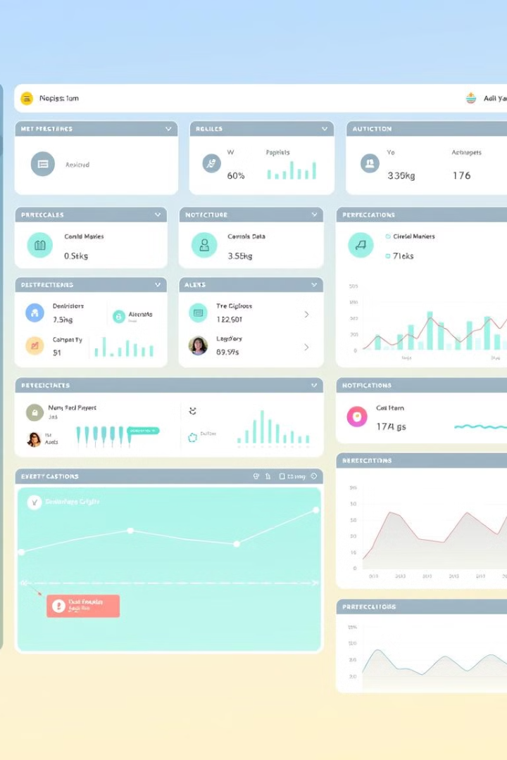



Monitoring & Feedback Service
Functionality
Tracks model performance and triggers retraining if necessary, maintaining model accuracy over time.
Technology Stack
Employs Prometheus, Grafana, and Kafka for monitoring and alerting.
Operations
Monitors prediction accuracy, logs errors, and notifies developers for retraining, ensuring continuous improvement.

Slide 8





Workflow of the SOA-Based ML System
Preprocessing & Engineering
Data Collection
2
1
Model Training & Evaluation
3
5
Monitoring & Feedback
4
Model Deployment & Prediction
The system follows a cyclical workflow, starting with data collection, moving through preprocessing and feature engineering, model training and evaluation, model deployment and prediction, and finally, monitoring and feedback.

Slide 9
Instructions for Running the ML Services
Clone Repository
1
git clone https://github.com/JB250101/INFO8665--Airplane.git
Navigate Directory
2
cd INFO8665--Airplane
Activate Environment
3
Windows: .\\airplanevenv\\Scripts\\activate, Mac/Linux: source airplanevenv/bin/activate
Follow these steps to set up and run the ML services. Ensure all dependencies are installed and the virtual environment is activated before proceeding.

Slide 10

Conclusion
The SOA-based ML architecture provides a structured approach to predicting airfare prices. The modularized services allow efficient data handling, model training, inference, and monitoring. The deployed services ensure a scalable and automated ML workflow for real-time airfare prediction.
This project demonstrates the effectiveness of SOA in managing complex machine learning workflows, providing a foundation for future enhancements and scalability.

